Slide 1
Anoton GridCal
Key Benefits
Near-vertical sidewalls exceeding 89.5° surpassing typical industrial standards for etched or conventional grids, ensuring exceptional geometric fidelity and minimal profile distortion
Outstanding line straightness and orthogonality enabled by the straight trajectories and low scattering inherent to proton beam writing
Sharp, well-defined edges with low line-edge roughness delivering cleaner features for precise calibration measurements
Durable, corrosion-resistant Pd surface optimised for reliable, repeated SEM imaging, including low-kV modes, with high secondary electron contrast
User-friendly hierarchical design coarse 2 μm fiducials spanning 1-2 mm allow rapid navigation from low to high magnification
Broad compatibility seamless use with SEM, AFM, optical metrology systems, and standard holders/stubs
Why GridCal Stands Out
Proton beam writing delivers benchmark geometric fidelity – straighter lines and cleaner edges than many conventional electron-beam or etched calibration grids – ensuring superior performance when precise pattern geometry is essential.
Looking to Purchase?
Ready to upgrade your calibration precision? Contact us today for quotes, samples, or SEM-verified data on the Anoton GridCal – the premium grid with near-vertical sidewalls exceeding 89.5°.
Premium Orthogonal Grid Resolution Standard
Proton Beam Written for Exceptional Straightness, Edge Quality, and Metrology Precision
The Anoton GridCal is a high-contrast resolution standard fabricated using proton beam writing (PBW) on a silicon substrate, with a deposited 2 nm titanium adhesion layer and 100 nm palladium top layer.
This method produces straight lines with near-vertical side walls exceeding 89.5° – surpassing typical industrial standards – along with minimal edge roughness, making it ideal for the most precise microscopy and metrology applications.
Central orthogonal grid horizontal + vertical lines forming a precise cross array
Nominal line width 2-5 μm, provided for each sample and consistent within
Nominal pitch 25 μm
Active central area Ranging from 100 μm to 200 μm
Guiding markers 1-2 μm wide lines extending to 1 mm in both X and Y directions for fast location at low magnification
Material Roughly 2 nm Ti + 100 nm Pd on Si substrate, providing high secondary electron contrast and electrical conductivity
Typical applications Magnification, distortion, orthogonality, resolution testing

Slide 2
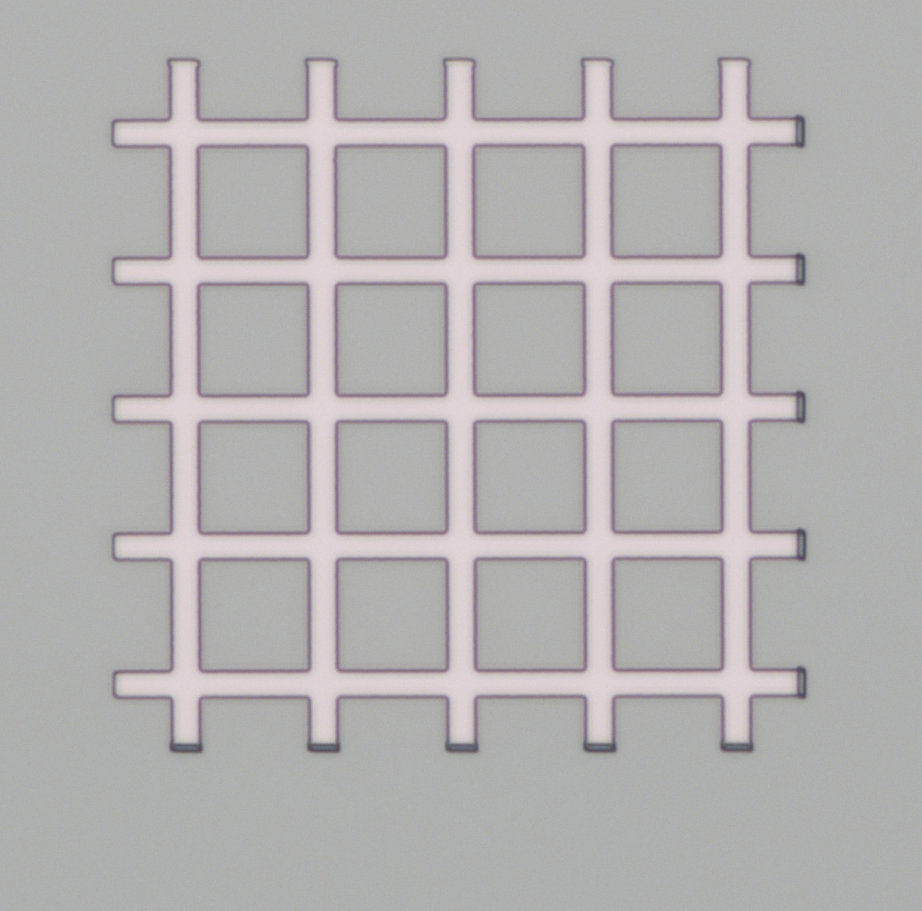
Anoton GridCal
Key Benefits
Near-vertical sidewalls exceeding 89.5° surpassing typical industrial standards for etched or conventional grids, ensuring exceptional geometric fidelity and minimal profile distortion
Outstanding line straightness and orthogonality enabled by the straight trajectories and low scattering inherent to proton beam writing
Sharp, well-defined edges with low line-edge roughness delivering cleaner features for precise calibration measurements
Premium Orthogonal Grid Resolution Standard
Proton Beam Written for Exceptional Straightness, Edge Quality, and Metrology Precision
The Anoton GridCal is a high-contrast resolution standard fabricated using proton beam writing (PBW) on a silicon substrate, with a deposited 2 nm titanium adhesion layer and 100 nm palladium top layer.
This method produces straight lines with near-vertical side walls exceeding 89.5° – surpassing typical industrial standards – along with minimal edge roughness, making it ideal for the most precise microscopy and metrology applications.
Central orthogonal grid horizontal + vertical lines forming a precise cross array
Nominal line width 2-5 μm, provided for each sample and consistent within
Nominal pitch 25 μm
Active central area Ranging from 100 μm to 200 μm
Guiding markers 1-2 μm wide lines extending to 1 mm in both X and Y directions for fast location at low magnification
Material Roughly 2 nm Ti + 100 nm Pd on Si substrate, providing high secondary electron contrast and electrical conductivity
Typical applications Magnification, distortion, orthogonality, resolution testing
25 μm
Durable, corrosion-resistant Pd surface optimised for reliable, repeated SEM imaging, including low-kV modes, with high secondary electron contrast
User-friendly hierarchical design coarse 2 μm fiducials spanning 1-2 mm allow rapid navigation from low to high magnification
Broad compatibility seamless use with SEM, AFM, optical metrology systems, and standard holders/stubs
Why GridCal Stands Out
Proton beam writing delivers benchmark geometric fidelity – straighter lines and cleaner edges than many conventional electron-beam or etched calibration grids – ensuring superior performance when precise pattern geometry is essential.
Looking to Purchase?
Ready to upgrade your calibration precision? Contact us today for quotes, samples, or SEM-verified data on the Anoton GridCal – the premium grid with near-vertical sidewalls exceeding 89.5°.-

